Slide 1
URBAN SOUND CLASSIFICATION
By Sai Krishna

Slide 2
Agenda
Abstract
Research Questions
Data set Overview
Methodology
Insights and Potential features
Model Development plan
Model Evaluation
References

Slide 3
Abstract
"The UrbanSound8K dataset serves as a cornerstone in the field of urban sound classification, providing researchers with a comprehensive benchmark dataset for evaluating classification algorithms. Developed by the research community, this dataset encompasses a diverse array of urban soundscapes captured from various environments, including urban streets, parks, transportation hubs, and residential areas."

Slide 4
Research Question
How effective are convolutional neural networks (CNNs) in classifying urban sounds using the UrbanSound8K dataset?
What features or combinations of features extracted from the audio data are most informative for urban sound classification?

Slide 5
Data set Overview
UrbanSound8K Dataset Overview:
Size: 8,732 labeled sound clips
Air Conditioner
Car Horn
Children Playing
Dog Bark
Drilling
Engine Idling
Gun Shot
Jackhammer
Siren
Street Music

Slide 6
Variety: Sound clips captured from various urban environments, providing a diverse range of acoustic events.
Metadata: Each sound clip is accompanied by metadata, including:
Recording location
Duration
Category label
Preprocessing: Before model training, the dataset will undergo preprocessing steps such as:
Feature extraction: Extracting relevant features from the audio data.
Normalization: Preprocessing the audio data to ensure uniformity and optimal performance during training.

Slide 7
Methodology
Data Preprocessing:
Feature Extraction: Extract relevant features from the audio data. Common techniques include Mel-frequency cepstral coefficients (MFCC), spectrograms, and other time-frequency representations.
Normalization: Normalize the audio data to ensure uniformity and optimal performance during model training. This may involve scaling the data to a standard range or applying z-score normalization.
Model Selection and Development:
Convolutional Neural Network (CNN): Utilize a CNN architecture for urban sound classification. CNNs have shown effectiveness in capturing spatial and temporal patterns in sequential data like sound.
Hyperparameter Tuning: Fine-tune hyperparameters such as learning rate, batch size, and number of layers through experimentation and validation.

Slide 8
Training:
Data Splitting: Split the dataset into training, validation, and test sets. A common split ratio is 80% for training, 10% for validation, and 10% for testing.
Regularization: Apply regularization techniques such as dropout or L2 regularization to prevent overfitting.
Model Evaluation:
Performance Metrics: Evaluate the model's performance using standard classification metrics such as accuracy, precision, recall, and F1 score.
Confusion Matrix: Visualize the model's performance across different sound classes using a confusion matrix.
ROC Curve and Precision-Recall Curve: Plot ROC curve and precision-recall curve to assess the model's performance at different classification thresholds.

Slide 9
Analysis and Interpretation:
Interpretation of Results: Analyze the model's performance and interpret the results. Identify sound classes where the model performs well and areas for improvement.
Insights: Draw insights from the analysis, such as the impact of different features or preprocessing techniques on model performance.
Iterative Improvement:
Fine-Tuning: Fine-tune the model based on feedback from evaluation metrics and domain knowledge.

Slide 10
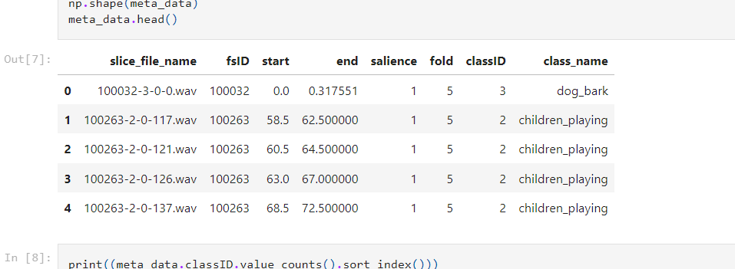
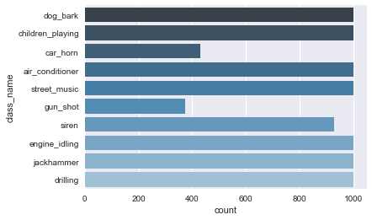
Insights and Potential Features
Dataset Classes

Slide 11
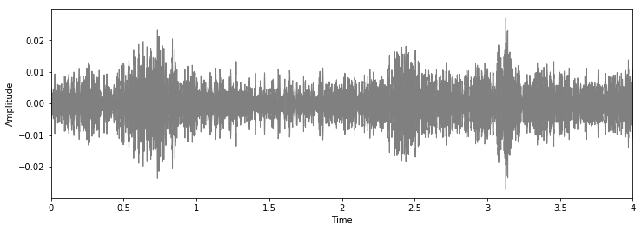
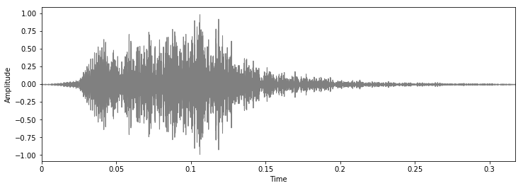
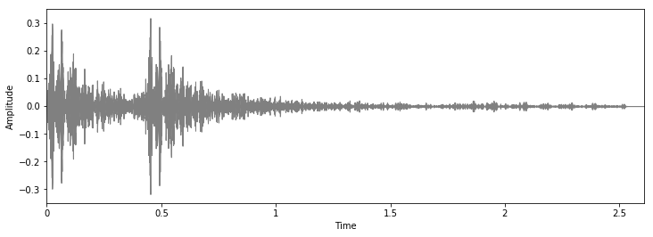
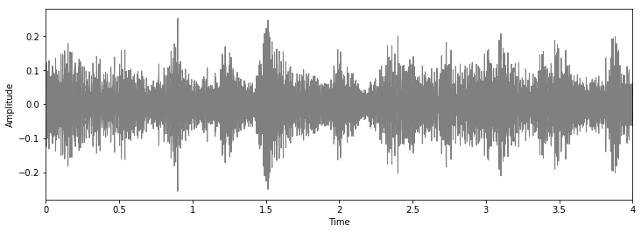
Child Playing
Dog Barking
Gun Shot
Street Music

Slide 12
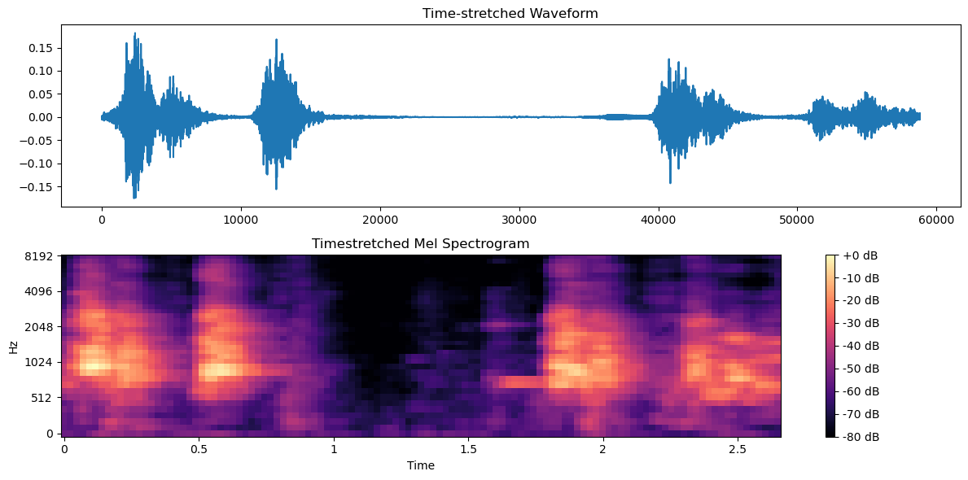

Slide 13
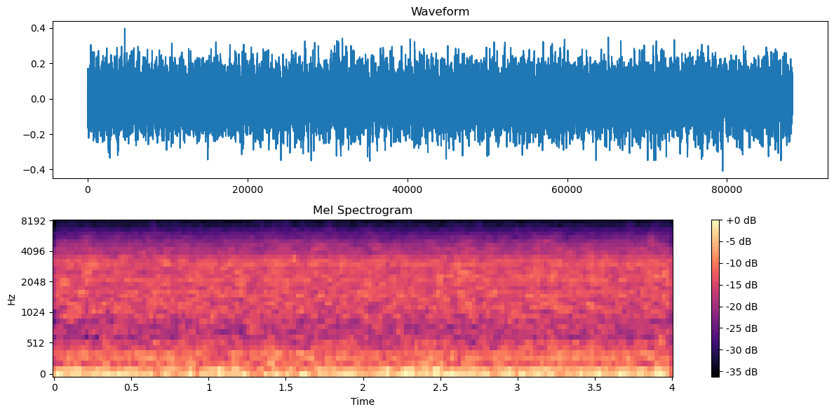

Slide 14
Model Development Plan
Data Preparation:
Preprocess the UrbanSound8K dataset by extracting relevant features and normalizing the audio data.
Model Selection:
Choose a Convolutional Neural Network (CNN) architecture, known for its effectiveness in sequential data like audio.
Model Architecture Design:
Design the CNN architecture consisting of convolutional layers followed by max-pooling layers and fully connected layers for classification.
Hyperparameter Tuning:
Fine-tune hyperparameters such as learning rate, batch size, and number of layers through experimentation and validation.

Slide 15
Training:
Split the dataset into training, validation, and test sets.
Train the CNN model using the training data, utilizing techniques like stochastic gradient descent (SGD) or Adam optimizer.
Evaluation:
Evaluate the model's performance using standard classification metrics such as accuracy, precision, recall, and F1 score.
Visualize the model's performance with a confusion matrix, ROC curve, and precision-recall curve.
Analysis and Interpretation:
Analyze the model's performance and interpret the results, identifying areas of strength and improvement.
Iterative Improvement:
Iterate on the model architecture, hyperparameters, and preprocessing techniques based on insights gained from the analysis.

Slide 16
Accuracy
Training Accuracy: 0.989692211151123
Testing Accuracy: 0.9227246642112732

Slide 17
Predictions
The predicted class is: drilling
air_conditioner : 0.00000000096021868234430485244957
car_horn : 0.00000000000000011661610804618305
children_playing : 0.00000000176181946809350620242185
dog_bark : 0.00000000000019882251227343328281
drilling : 0.99999308586120605468750000000000
engine_idling : 0.00000000131292154925688464572886
gun_shot : 0.00000000000018252357904171429004
jackhammer : 0.00000682402060192544013261795044
siren : 0.00000000001389500146886657461209
street_music : 0.00000010089981117289426038041711

Slide 18
The predicted class is: air_conditioner
air_conditioner : 1.00000000000000000000000000000000
car_horn : 0.00000000000000005783933378334958
children_playing : 0.00000001089141576926522247958928
dog_bark : 0.00000000000236615154552977102753
drilling : 0.00000000017974469135317860946088
engine_idling : 0.00000000000691622367016142547413
gun_shot : 0.00000000093781726828723321887082
jackhammer : 0.00000000012537700044834565460405
siren : 0.00000000166928770806151760552893
street_music : 0.00000000000282763244242867362033

Slide 19
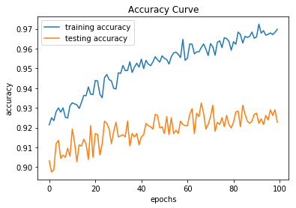
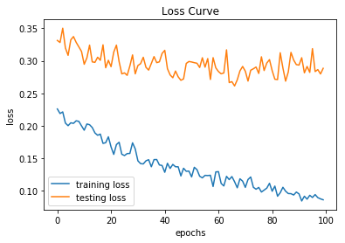
Training & Testing curves

Slide 20
Classifications
precision recall f1-score support
Air Conditioner 0.92 0.94 0.93 203
Car Horn 0.98 0.97 0.97 86
Children Playing 0.84 0.89 0.86 183
Dog bark 0.91 0.94 0.92 201
Drilling 0.94 0.90 0.92 206
Engine Idling 0.92 0.98 0.95 193
Gun Shot 0.93 0.97 0.95 72
Jackhammer 0.96 0.95 0.95 208
Siren 0.91 0.97 0.94 165
Street Music 0.94 0.81 0.87 230
avg / total 0.92 0.92 0.92 1747

Slide 21
Model Evaluation
Metrics: Calculate accuracy, precision, recall, and F1 score.
Confusion Matrix: Visualize class-wise performance.
ROC Curve: Evaluate true positive rate vs. false positive rate.
Precision-Recall Curve: Assess precision vs. recall.
Cross-Validation: Ensure generalization and robustness.
Comparison: Compare with baseline models.
Ablation Studies: Investigate key factors' impact.

Slide 22
References
Salamon, J., & Bello, J. P. (2017). Deep convolutional neural networks and data augmentation for environmental sound classification. IEEE Signal Processing Letters, 24(3), 279-283.
Piczak, K. J. (2015). Environmental sound classification with convolutional neural networks. In Proceedings of the IEEE 25th International Workshop on Machine Learning for Signal Processing (MLSP) (pp. 1-6).
Salamon, J., Jacoby, C., & Bello, J. P. (2014). A dataset and taxonomy for urban sound research. In Proceedings of the 22nd ACM international conference on Multimedia (pp. 1041-1044).
Choi, K., Fazekas, G., Sandler, M., & Cho, K. (2017). Transfer learning for music classification and regression tasks. In Proceedings of the 18th International Society for Music Information Retrieval Conference (ISMIR) (pp. 323-330).

Slide 23
THANK YOU

